Slide 1
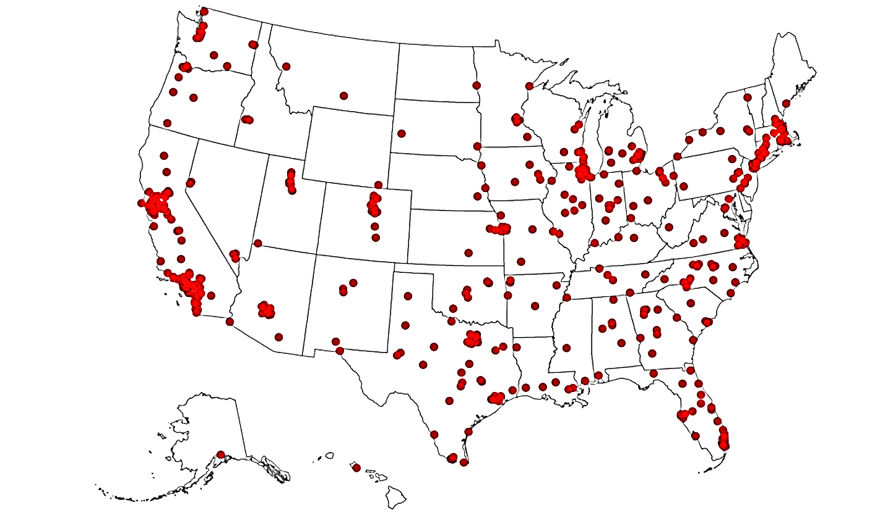
“500 Cities: Local Data for Better Health”
Team II
Vineela Datla
Anant Khandelwal
Jose Perez
https://www.cdc.gov/500cities/

Slide 2
Agenda
Background
Goal of the project
Exploratory Data Analysis
Feature Engineering
Models
Results
Analysis

Slide 3
Background
Data Background | In 2010, 78.8% of US adults self-reported having good or better physical health. (2)
Significance | Physical health is an important component of Health-related quality of life (HRQOL), a multi-dimensional concept that focuses on the impact of health status on quality of life.
Limitations of indicator | This measure is based on self-assessment only and does not include an objective health component. Self-rated health status is a subjective measure; therefore, assessing the reliability and validity is difficult.
Data resources | Behavioral Risk Factor Surveillance System (BRFSS).
Limitations of data resources | As with all self-reported sample surveys, BRFSS data might be subject to systematic error resulting from noncoverage, nonresponse, or measurement bias. In an effort to address noncoverage issues related to phone use, BRFSS began including cell phone interviews in the 2011 data collection. Due to changes in sampling and weighting methodology, 2011 is a new baseline for BRFSS, and comparisons with prior year data are inappropriate.
Related recommendations | Healthy People 2020 objective HRQOL/WB-1.1: Increase the proportion of adults who self-report good or better physical health.
Notes:
The 500 Cities project is a collaboration between CDC, the Robert Wood Johnson Foundation, and the CDC Foundation. The purpose of the 500 Cities Project is to provide city- and census tract-level small area estimates for chronic disease risk factors, health outcomes, and clinical preventive service use for the largest 500 cities in the United States. These small area estimates will allow cities and local health departments to better understand the burden and geographic distribution of health-related variables in their jurisdictions, and assist them in planning public health interventions.

Slide 4
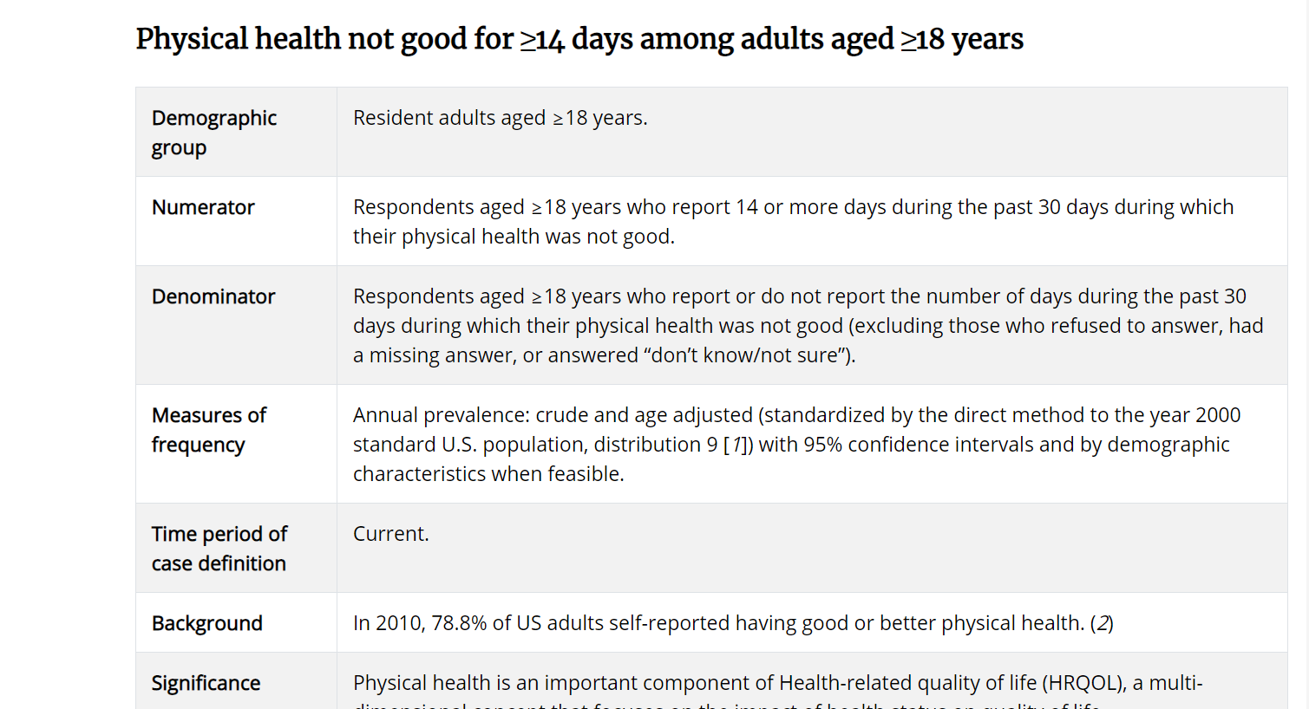

Slide 5
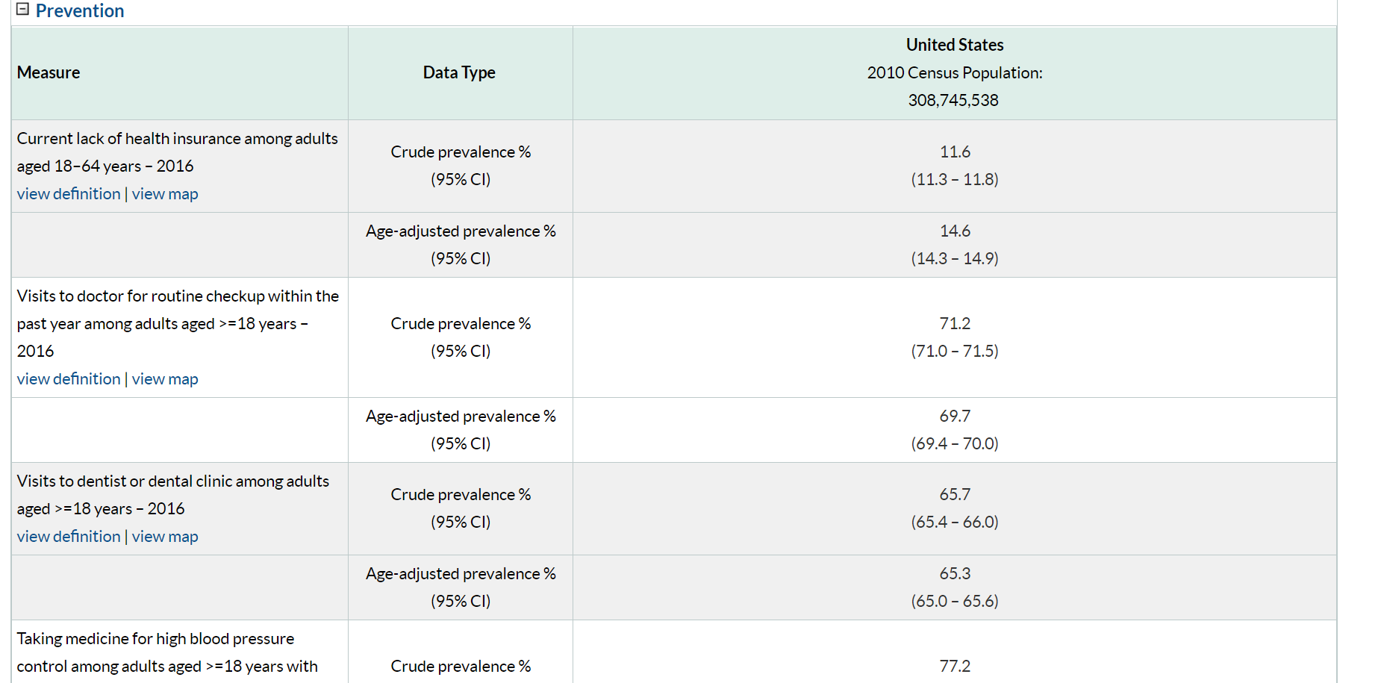

Slide 6
Goal of the Project
Trying to Predict “physical health not good for >14 days”
Based on independent variables:
Prevention: Current lack of health insurance, visits to doctor within past year, visits to dentist, taking medicine for BP, cholesterol screening, mammography, pap smear, fecal occult blood test, up to date on preventative services for men (or women)
Unhealthy Behaviors: Binge drinking, smoking, no leisure time physical activity, obesity, sleeping less than 7 hours
Notes:
Physical health is the state of being free from illness or injury. It can cover a wide range of areas including healthy diet, healthy weight, dental health, personal hygiene and sleep. Physical health is vital for overall well-being. Chronic illness like cancer, diabetes, asthma, arthritis cannot be cured but can be managed. Putting into practice the old saying 'prevention is better than cure' – modelled physical health not being good for more than 14 days to identify the most significant contributors.

Slide 7
Data Wrangling
Missing value detection
Column Extraction
Imputation
Cleaned Data
Notes:
Extracted the columns with name CrudePrev
Detected missing values: PAPTEST_CrudePrev (47 rows)
Calculated mean of column PAPTest based on state
Replaced missing values with the mean of the column

Slide 8
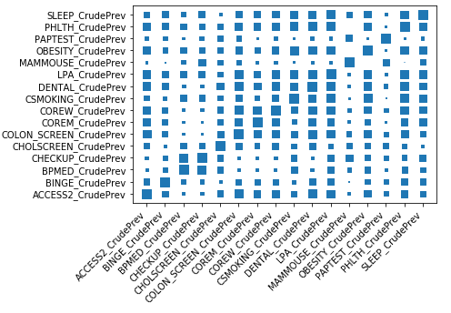
Exploratory Data Analysis
1. Correlation Matrix

Slide 9
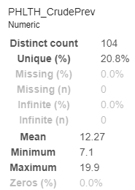
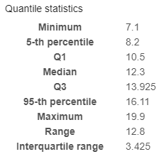
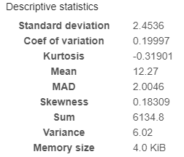
Exploratory Data Analysis
2. Profiling:

Slide 10
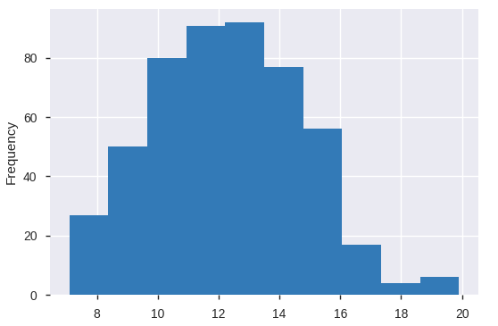
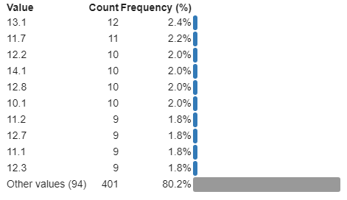
Exploratory Data Analysis
2. Profiling (Histogram):

Slide 11
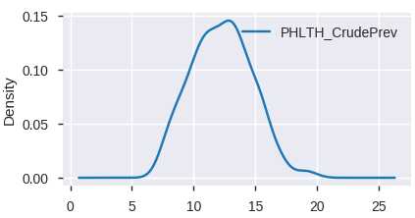
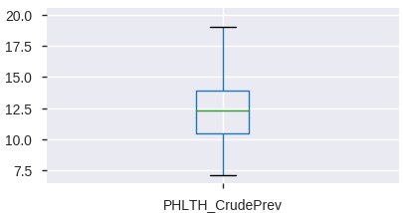
Exploratory Data Analysis
2. Density plot:
3. Box and whisker plots:

Slide 12
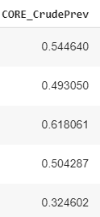
Feature Engineering
We have two variables for "Up-to-date on a core set of clinical preventive services among men & women aged ≥65 years" - Calculating a new term by averaging both the variables.
Core_CrudePrev = Avg (COREM_CrudePrev + COREW_CrudePrev)

Slide 13
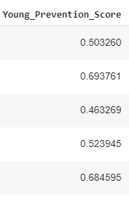
Feature Engineering
We are trying to build a Generalized Prevention score for columns based on Young adults.
The score is calculated by averaging % of “Use of basic preventive services”:
ACCESS2_CrudePrev
CHECKUP_CrudePrev
DENTAL_CrudePrev
BPMED_CrudePrev
CHOLSCREEN_CrudePrev
Young Prevention Score = Avg (1+2+3+4+5)

Slide 14
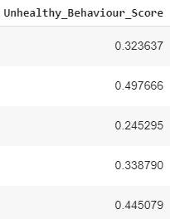
Feature Engineering
Similarly building an unhealthy behaviour score using columns:
BINGE_CrudePrev
CSMOKING_CrudePrev
LPA_CrudePrev
OBESITY_CrudePrev
SLEEP_CrudePrev
Unhealthy Behaviour Score = Avg (1+2+3+4+5)

Slide 15
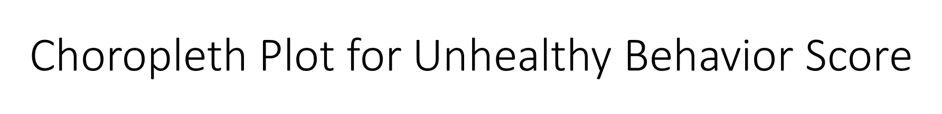
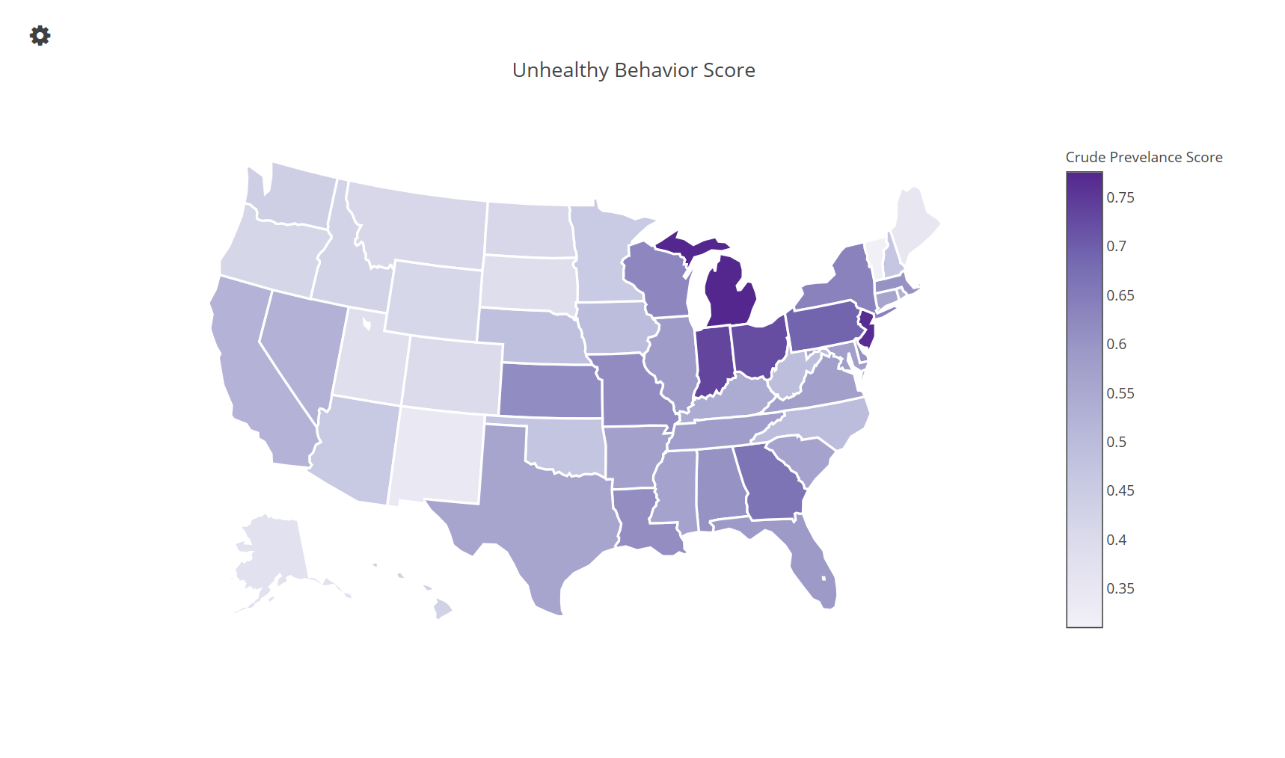

Slide 16
Models Tried:
Baseline Model
Random Forest
Gradient Boosting
Poisson Regression
Best Models: Random Forest & Gradient Boosting

Slide 17
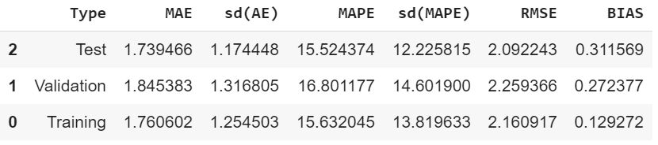
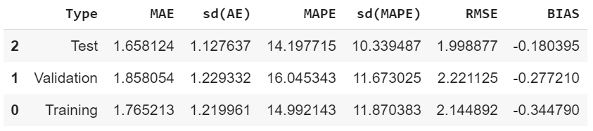
Error Metrics of 2 best models:
Error Metrics of RF:
Error Metrics of GBM:

Slide 18
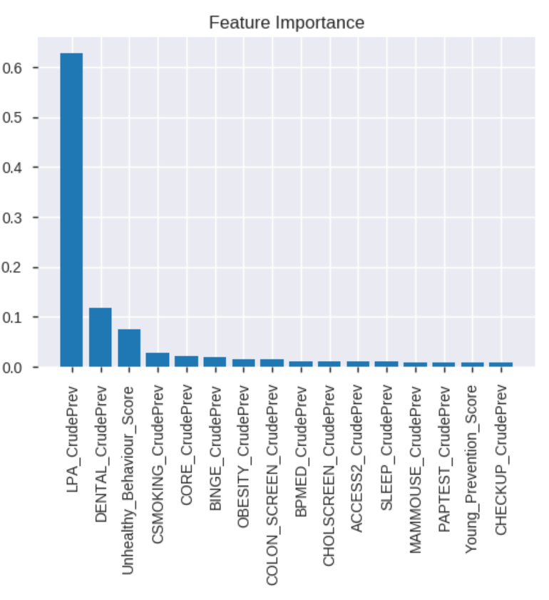
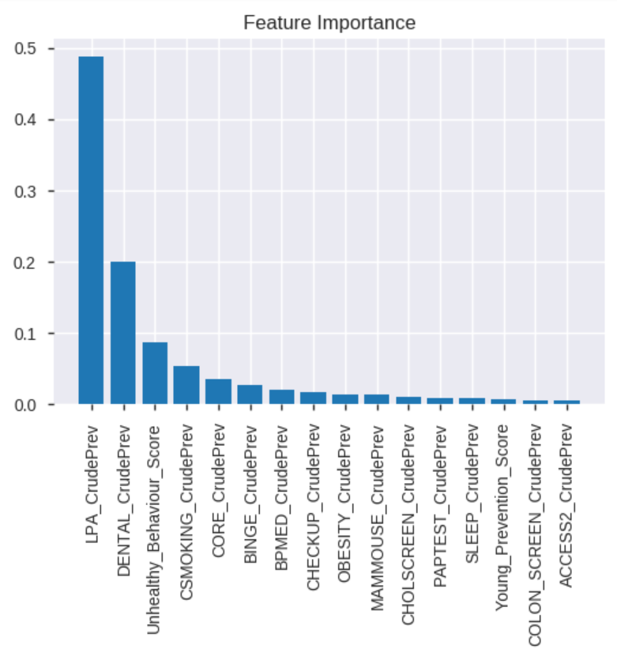
Variable Importance:
Feature Importance of RF: Feature Importance of GBM:
Notes:
1.No leisure-time physical activity among adults aged ≥18 years
2.Visits to dentist or dental clinic among adults aged ≥18 years
3.Unhealthy Behavior Score
4.Current smoking among adults aged ≥18 years

Slide 19
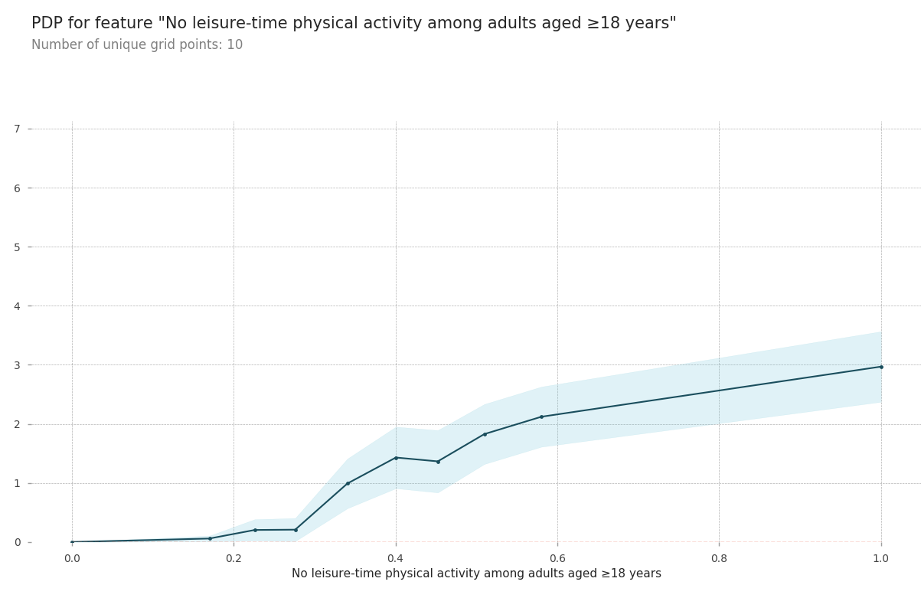
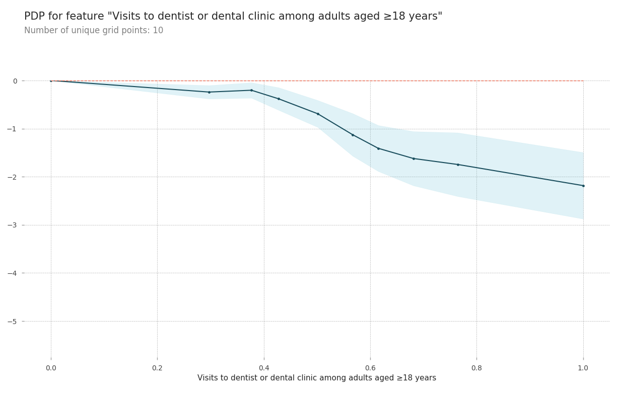
Partial Dependence Plots

Slide 20
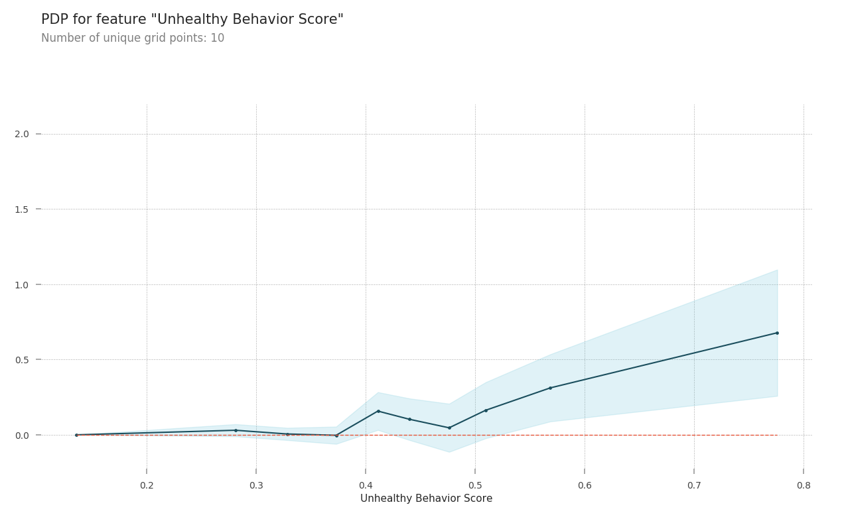
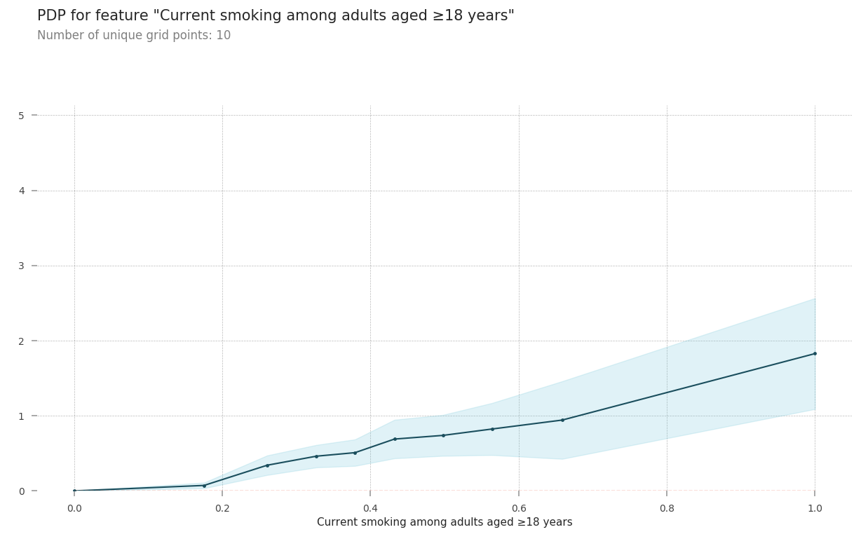
Partial Dependence Plots

Slide 21
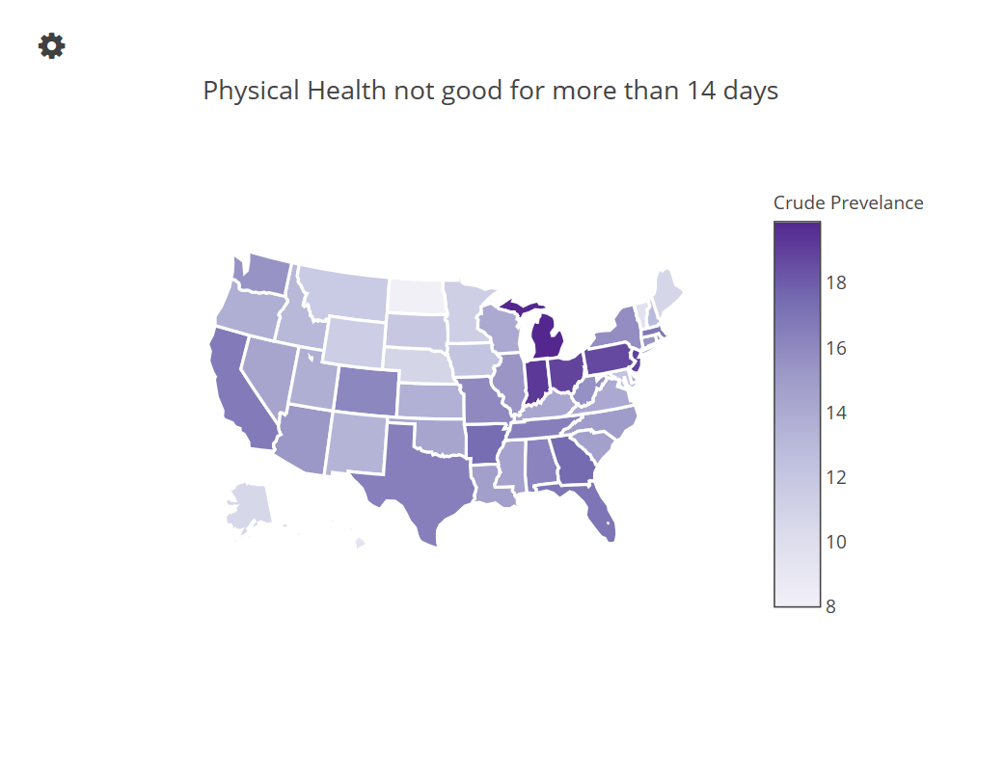
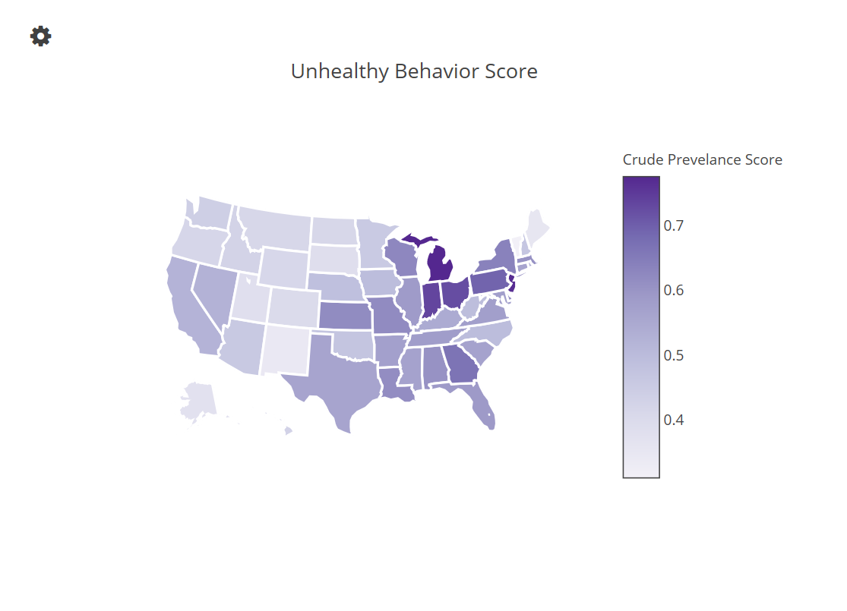
https://plot.ly/~VineelaD/7/
https://plot.ly/~VineelaD/12/
Notes:
Midwest, Northeast and south

Slide 22
Conclusion:
No leisure time physical activity and Unhealthy Behaviors are the most important variables.
Models are best predicting mid range predictions.
Model can help insurance providers offer better premiums based on the persons health.

Slide 23


Questions????

